Slide 1

ANALYTICAL CRM DEVELOPMENT FOR- BANK CHURN ANALYSIS
-BY Akash Borade

Slide 2


Understanding Bank Churn
What Is Bank Churn?
Bank Churn refers to the phenomenon of customers leaving a bank. It is an Important metric for banks to track as it directly Impacts their customer base and revenue.
Why Analyze Bank Churn?
Analyzing bank churn helps banks understand the reasons behind customer attrition and identify areas for improvement. It allows banks to develop strategies to retain existing customers and attract new ones.

Slide 3
Factors Contributing to Bank Churn
When analyzing the reasons behind bank churn, several factors comes into play. Understanding these factors can help
Banks Identify areas for improvements and implement strategies to retain customers.
Factors Contributing to Bank Churn
Factor | Description
Customer Satisfaction | Low levels of customer satisfaction can lead to churn. Dissatisfaction with customer Service, long wait times, and Unresolved issues are common reasons why customers churn banks.
Fees and Charges | High fees and charges can be a significant deterrent for customers. If a banks fees are higher compared to or if customers feel they are being charged unfairly, they may choose to switch banks.
Competition | Intense competition in the banking industry can lead to churn, If a competitor offers better rates, incentives, or a more user-friendly experience, customers may be tempted to switch banks.

Slide 4
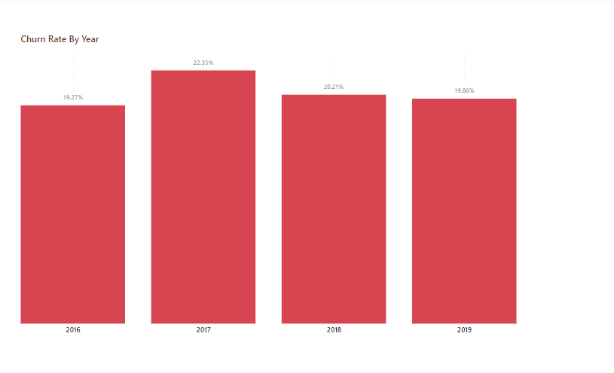

Slide 5
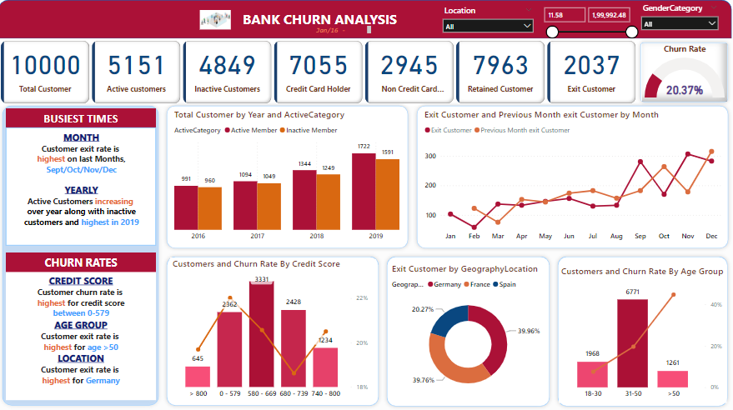

Slide 6
Retention Strategies
Retention Strategies to Reduce Bank Churn
Strategy | Description
Personalized Offers | Provide tailored offers and incentives based on customer preferences and behavior to encourage retention.
Customers Loyalty Programs | Implement loyalty programs that reward customers for their continued business and encourage them to stay with the bank.
Improved Customer Service | Enhance the customer service experience service experiences by providing and personalized assistance, resolving issues efficiently, and addressing customer feedback.

Slide 7
Key Takeaways
Customer Satisfaction
Customer satisfaction is a critical factor in bank churn.
Dissatisfied customers are more likely to switch banks.
Predictive Models
Predictive Models can help identify customers at risk of churn.
By analyzing customers data, predictive models can identify patterns and indicators of churn.
Retention Strategies
Effective retention strategies can help reduce churn.
Providing personalized offers and incentives can incentivize customers to stay with the bank.

Slide 8
THANK YOU!

